Slide 1



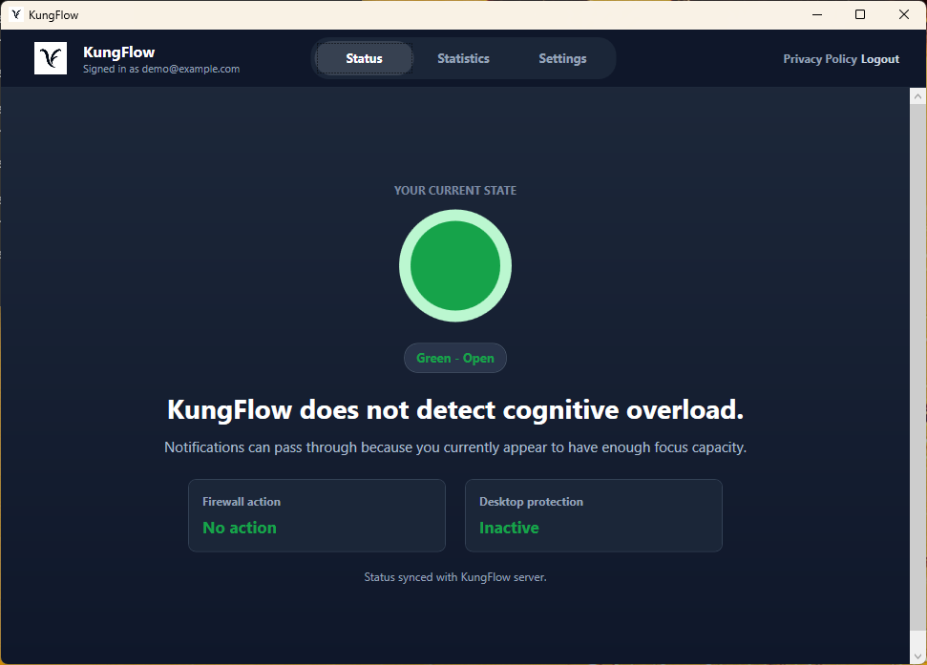
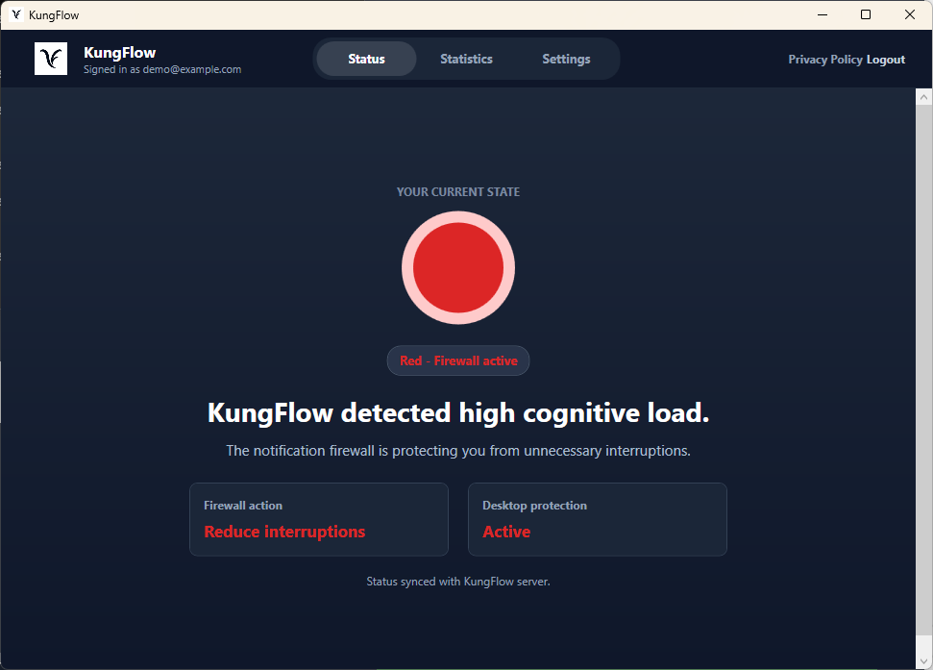


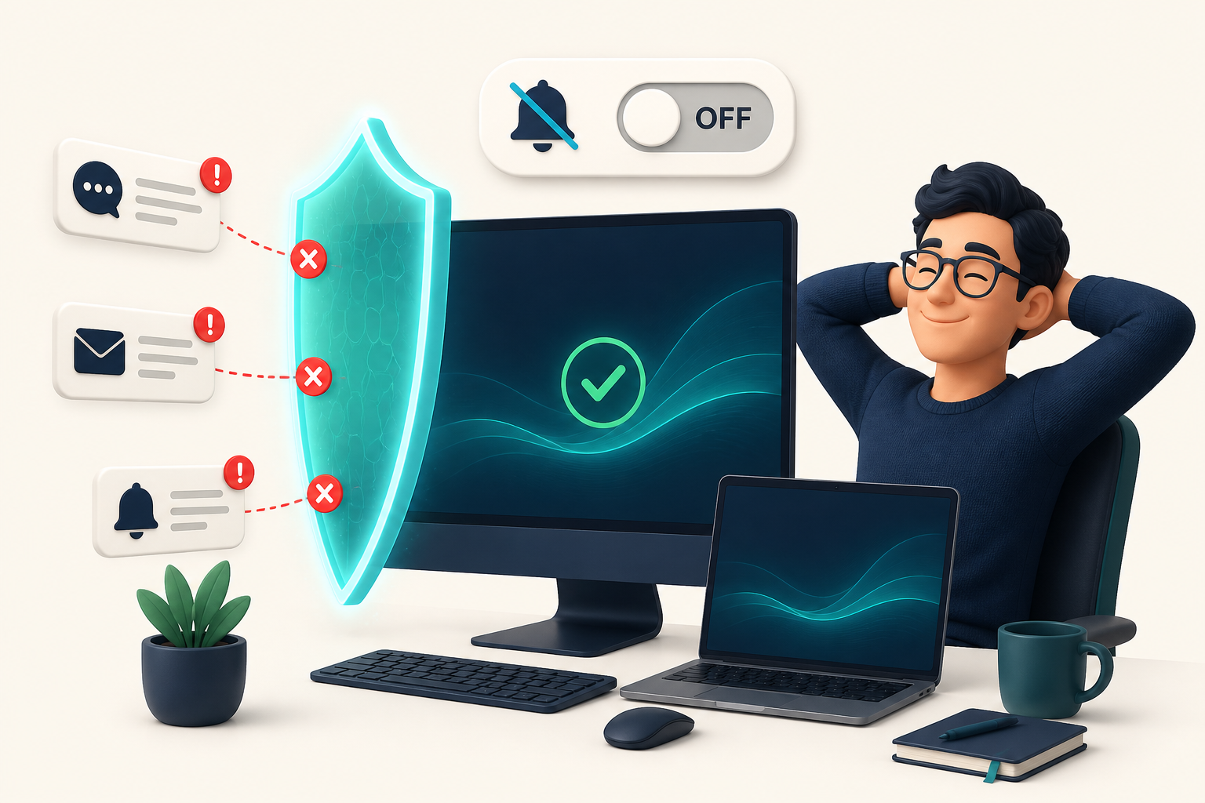









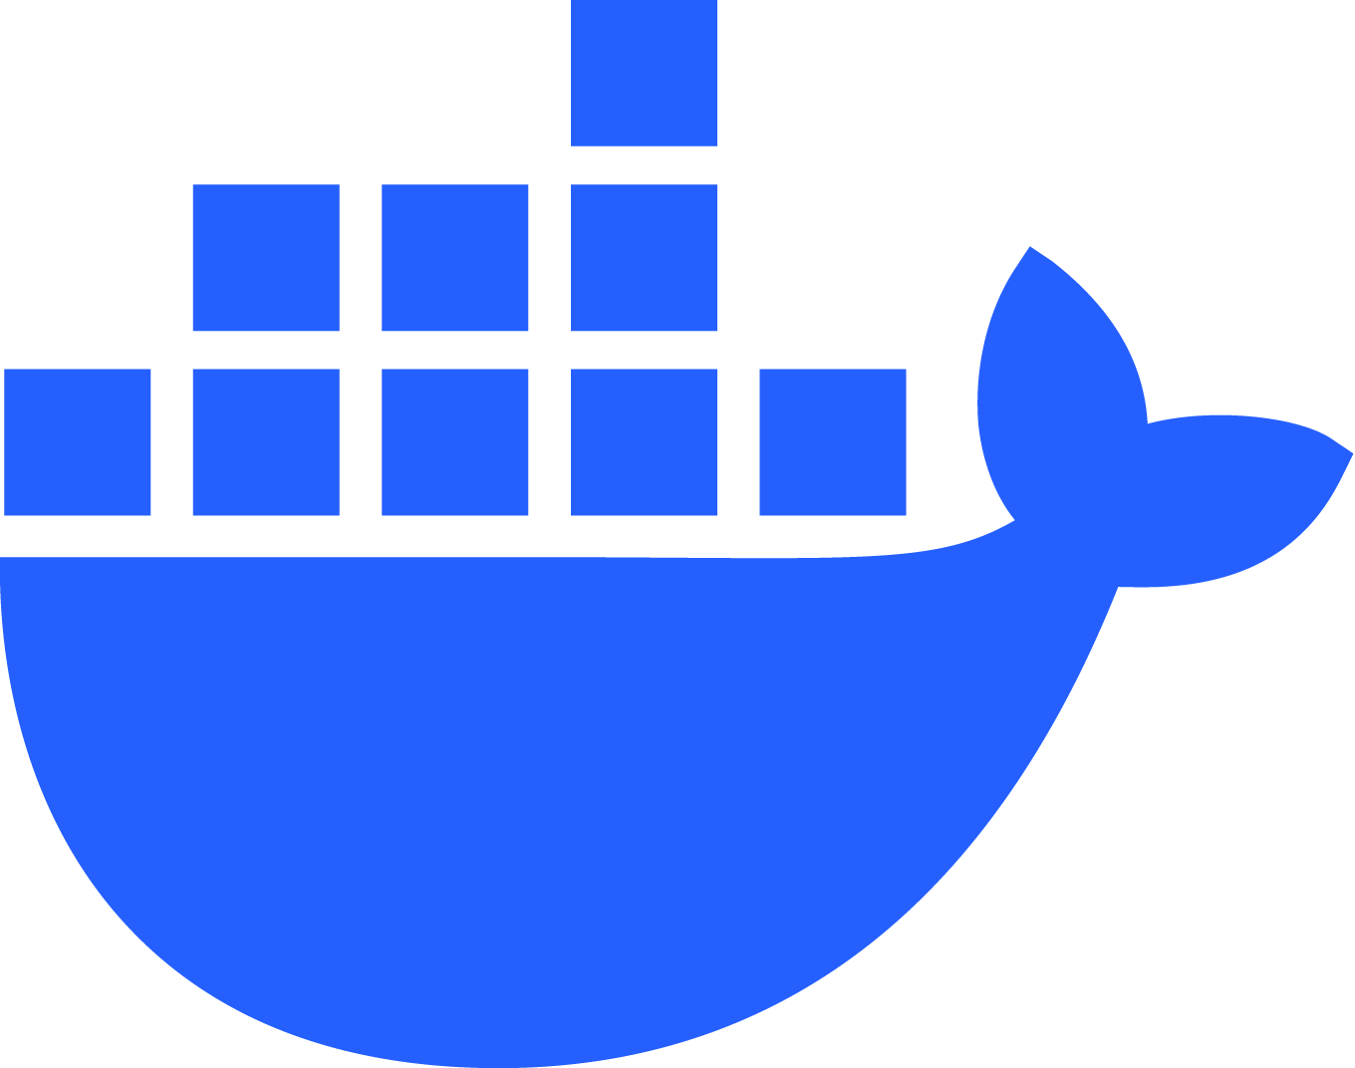
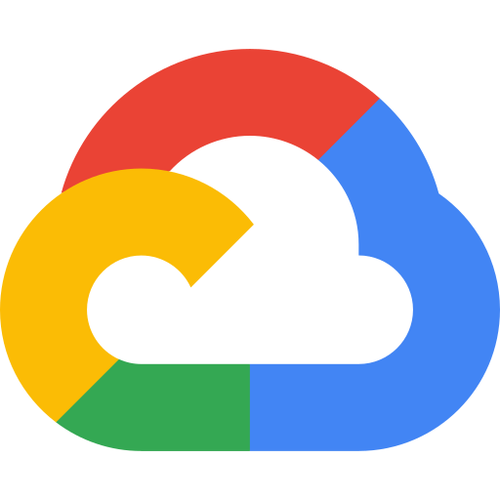
KungFlow
Supervisor: Dror Margalit
PROTECT YOUR FOCUS.
Project No.: 15002936
Ido Mark • Rotem Saraf • Eden Elkayam
01
Why does it matter?
The cost of interruptions—and the promise of automatic protection
In today’s digital workplace, focus is constantly under attack.
Notifications, messages, and frequent context switching repeatedly interrupt computer - based work. Employees lose concentration, work less efficiently, and experience greater frustration - while employers lose valuable time, productivity, and work quality.
56
23 min
STRESS ↑
THE PROMISE
interruptions
per workday
to regain
deep focus
more frustration
and time pressure
A background agent that senses overload and protects the individual focus - automatically.
02
What did we build?
A working Windows agent that detects the moment protection is needed
KungFlow runs quietly in the background, monitors behavioral rhythm - not content - and changes the protection state only when overload is detected.
NORMAL WORK · MONITORING IN THE BACKGROUND
OVERLOAD DETECTED · PROTECTION IS NEEDED
Green state → no overload detected, so work continues normally
Red state → the server identifies overload and returns a protection decision
WITHOUT KUNGFLOW
WITH KUNGFLOW
The user stays focused on the task while KungFlow quietly observes the work rhythm.
Same overload, different outcome: without KungFlow interruptions continue; with KungFlow protection activates automatically.
03
How did we build it?
A personalized detection loop across the desktop agent, server and SQL storage
PROTECTION DECISION RETURNS TO THE AGENT
DESKTOP AGENT
KUNGFLOW SERVER
SQL
SQL DATABASE
Collects typing rhythm, mouse movement, window switching and open-window patterns. Sends one-minute samples and applies the returned decision.
Scores current load against the user’s personal baseline, stores the current state, and returns shouldSilenceNotifications to the agent.
Stores users, sessions, behavioral metrics, personal baselines and the current cognitive state.
ACTIVITY SAMPLE
METRICS + BASELINE
C#
.NET
Windows
Node.js
Express
Google Cloud Run
SQL • Google Cloud SQL
DEVELOPMENT & DEPLOYMENT
Docker
KungFlow — PROTECT YOUR FOCUS.
Notes:
[Sources]
Problem statistics and internal product claims: Hub/KungFlow Investor Pitch v3.pptx and project source code.
Product screenshots: docs/product-demo-assets/screens.
KungFlow and college logos: project/user-provided assets.
Scenario visuals: generated with the built-in Image Generation tool for this poster; conceptual illustrations, not Windows screenshots.
[/Sources]
New section-2 visual: poster/assets/scenario-normal-work.png, generated with the built-in Image Generation tool; conceptual illustration.
Official Cloud Run and Cloud SQL icons: https://cloud.google.com/icons
Official Docker mark: https://www.docker.com/company/newsroom/media-resources/
Official Git logo: https://git-scm.com/community/logos
Google Cloud icon: https://images.icon-icons.com/2699/PNG/512/google_cloud_logo_icon_171058.png
Official icon library: https://cloud.google.com/icons
Server-rack icon: https://www.flaticon.com/free-icon/server_6478097 (asset: https://cdn-icons-png.flaticon.com/512/6478/6478097.png)

